Slide 1
Physics of the Bow and Arrow
Physics 101
Fall Semester 2008

Slide 2
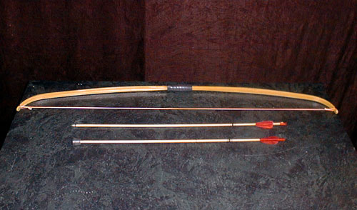
A simple long bow
There are many variations

Slide 3
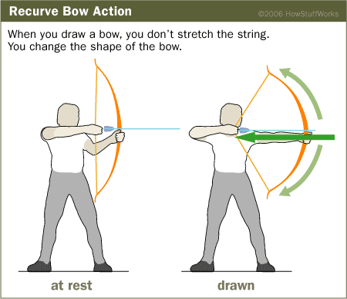

Slide 4
Several Factors can effect how powerful a bow is
Its size: Simple longbows are much more powerful than simple short bows.
Its shape: The first bows were simple curves of wood. Recurve bows, used today in Olympic archery events, curve away from the user at the end of each limb. These curves shorten the bracing height, the distance between the string and the bow at rest. This means that the string travels farther before coming to a stop and releasing the arrow, which can give the arrow a little extra momentum. The shape of the bow also causes it to apply additional spring force to the string.
Its composition: A bow's density and tensile strength determine how much energy it can hold and how well it can return to its original shape when shot. English longbows were often made from yew wood because it was strong and elastic. Many modern bows are composite bows, which use different materials in different parts of the bow, making some parts more flexible and others more rigid.

Slide 5
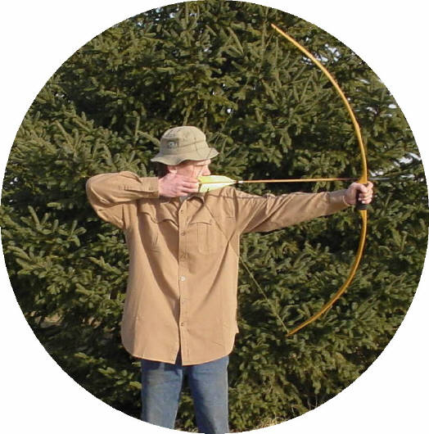
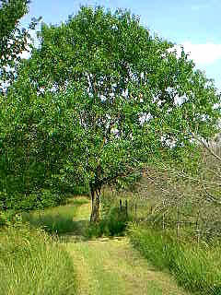
Sport bows today are made from many composite woods. However, Native Americans claimed the best bows for the plains Indian were made from Osage Orange. Ironically the osage tree was not found on the midwestern and western plains. Indians probably traded for the wood found originally in Texas, Oklahoma and Arkansas.-
Jamie Easter shooting an osage bow.
Visit Jamie’s website if you every have the desire to make an osage orange bow. Jamie sells materials and a DVD
http://www.osageorange.com/
An osage orange tree

Slide 6
The Battle of Agincourt 1415 AD
In 1415 AD King Henry V took a small army to France to enforce England’s claim to the French Throne (part of the 100 years war)
50,000 French soldiers faced 6000 English soldiers
The English army consisted of 80% bowmen; The French had virtually none
The massive French army was met by a storm of English arrows
The French army was routed

Slide 7
What English Bowyers used
Medieval bowyers had no choice of material but wood
The best wood (England) was the yew tree which has a maximum elastic energy of 700 J kg⁻¹ about as good as spring steel
Few bows from this era have survived but some arrows have
'archer's paradox' demands that a particular bow needs an arrow of suitable spine (stiffness) then by measuring the properties of a medieval arrow we can estimate the strength of the bow for which it was designed

Slide 8
By measuring the properties of medieval arrows we can estimate the strength of the English bows to be almost unbelievable
The force needed to draw a medieval longbow could have been in the range 110 – 180 lbs.
Some bows were eventually discovered in the wreck of Henry VIII’s ship Mary Rose (sand in 1545) confirmed this evidence
Henry had about 5000 archers and a stock of 400,000 arrows. Each archer could shoot 10 arrows a minute so the English army had eight minutes of firepower. 50,000 arrows a minute (800 a second) rained down on the French killing hundreds of men a minute.

Slide 9
Shot from an extremely powerful bow the 60 gram arrow would have a v₀ of 60 m/s. Aimed high in the air this arrow would have a 240 m range and arrive with a speed between 40 and 45 m/s.
Most French soldiers wore armour (a suit of 30 – 45 kg) made of wrought iron (soft).
The thickness of the suit varied according to the part of the body being protected. The thickest armour was 4 mm while the thinnest was 1 mm. The arrow could easily penetrate the latter.

Slide 10
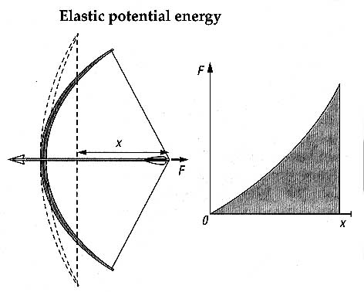
Start with a simple assumption that all PE is converted to KE ½mv² = ½ eFx
or solving v = (eFx/m)⁻² where e is an efficiency term (medieval bows 0.9)

Slide 11
But this is an overestimate. Why? When the arrow leaves the bow parts of the bow are moving which means that they have KE. Let us modify our original model.
½ mv² + k ½ Mv² = ½ eFx
M is the mass of the bow and k is a factor which represents the sum of the KE’s of the moving parts of the bow. (k for medieval bows range from 0.03 and 0.07
Thus v = sqrt( eFx / (m + kM))

Slide 12
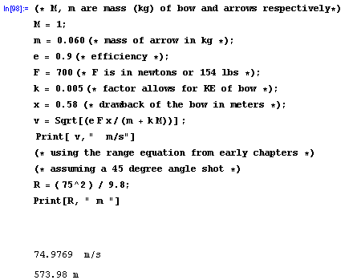
Solution using Mathematica 4.0
We have not taken into account the air drag on the arrow

Slide 13
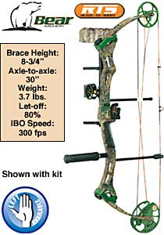
Compound Bows
The more work you have to do to draw a bow, the more energy it can transfer to an arrow. Compound bows use pulleys to help people do more work on the bow with less physical effort. In addition, when fully drawn, a compound bow's pulleys often hold part or even most of the draw weight. This is known as let-off, and it allows a person to hold and aim a drawn bow without as much strain or fatigue.
FROM Cabela’s catalog of hunting equipment: pictured compound bow about $450

Slide 14
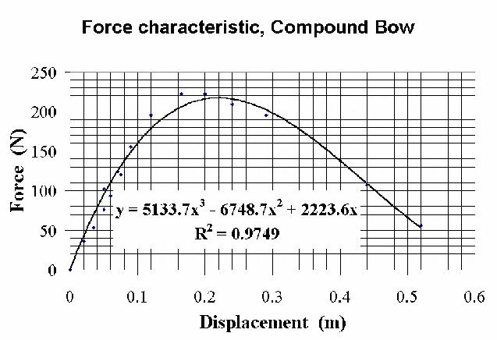
Data take from: http://physics.mercer.edu/petepag/combow.html

Slide 15
References Used
http://www.stortford-archers.org.uk/medieval.htm The Physics of Medieval Archery
http://www.osageorange.com/
Jamie Easter’s web page
http://physics.mercer.edu/petepag/combow.html
Data on a compound bow from a published paper

